Slide 1
Pulaski County Sewerage Authority
Sanitary Sewer Collection System Condition Assessment and Rate Study
Public Hearing
July 17, 2018
Riverlawn Elementary School
Sheryl Stephens
Victor Valenzuela

Slide 2
Presentation Overview
Flow Monitoring Analysis
CCTV Inspections and Sewer Collection System Condition Assessment
Pump Station Inspections and Condition Assessment
Rate Studies/Financial Analysis

Slide 3
Flow Monitoring Analysis
Inflow &
Infiltration
Total I/I During Monitoring Period: 11.8 MG
Treatment/Conveyance Cost: $1,680/MG
Conveyance and Treatment of I/I Annually: $19,825

Slide 4
Flow Monitoring Analysis
Sewer Response to 2.4-inch Rain Event
Peaking Factor =14.3

Slide 5
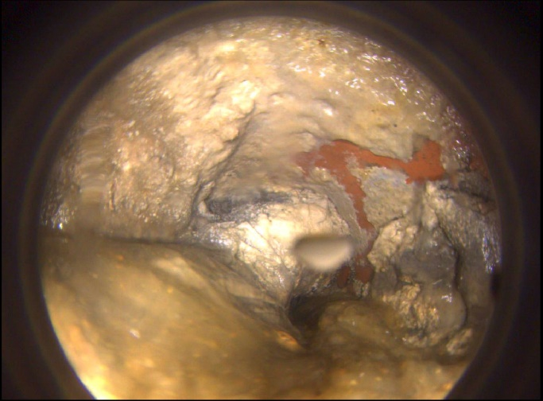
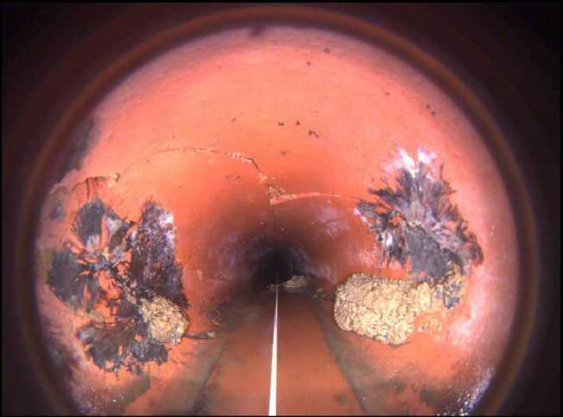
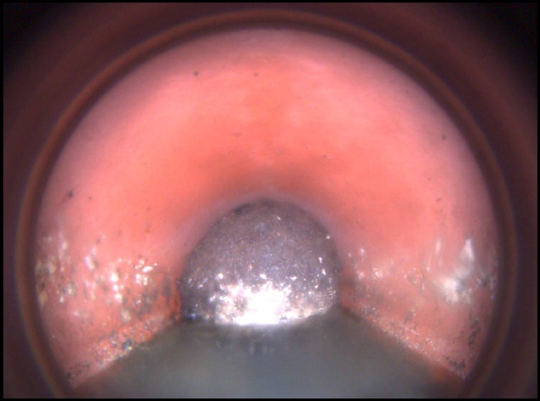
CCTV Inspections
Summary:
Total LF in Fairlawn Collection System: ~90,000 LF
Inspected Linear Footage: ~15,000 LF (1/6 of System)
Snap Shots:
Line 25-24: Grease
Line 36-35: Point Repair
Line 35-34: Root Ball

Slide 6
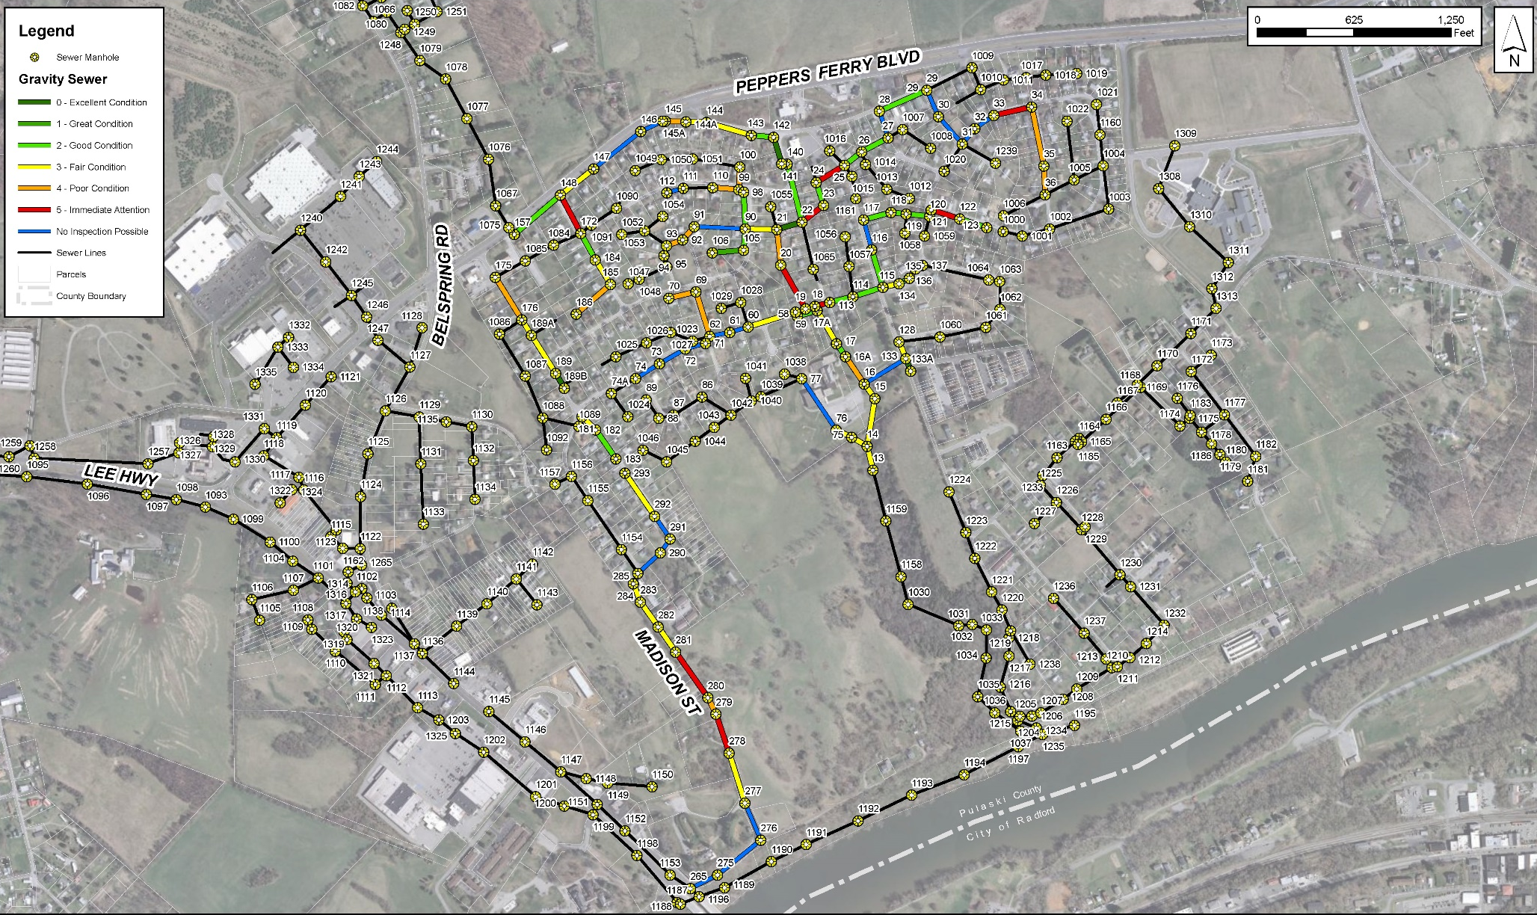
CCTV Inspections
PACP Scores

Slide 7
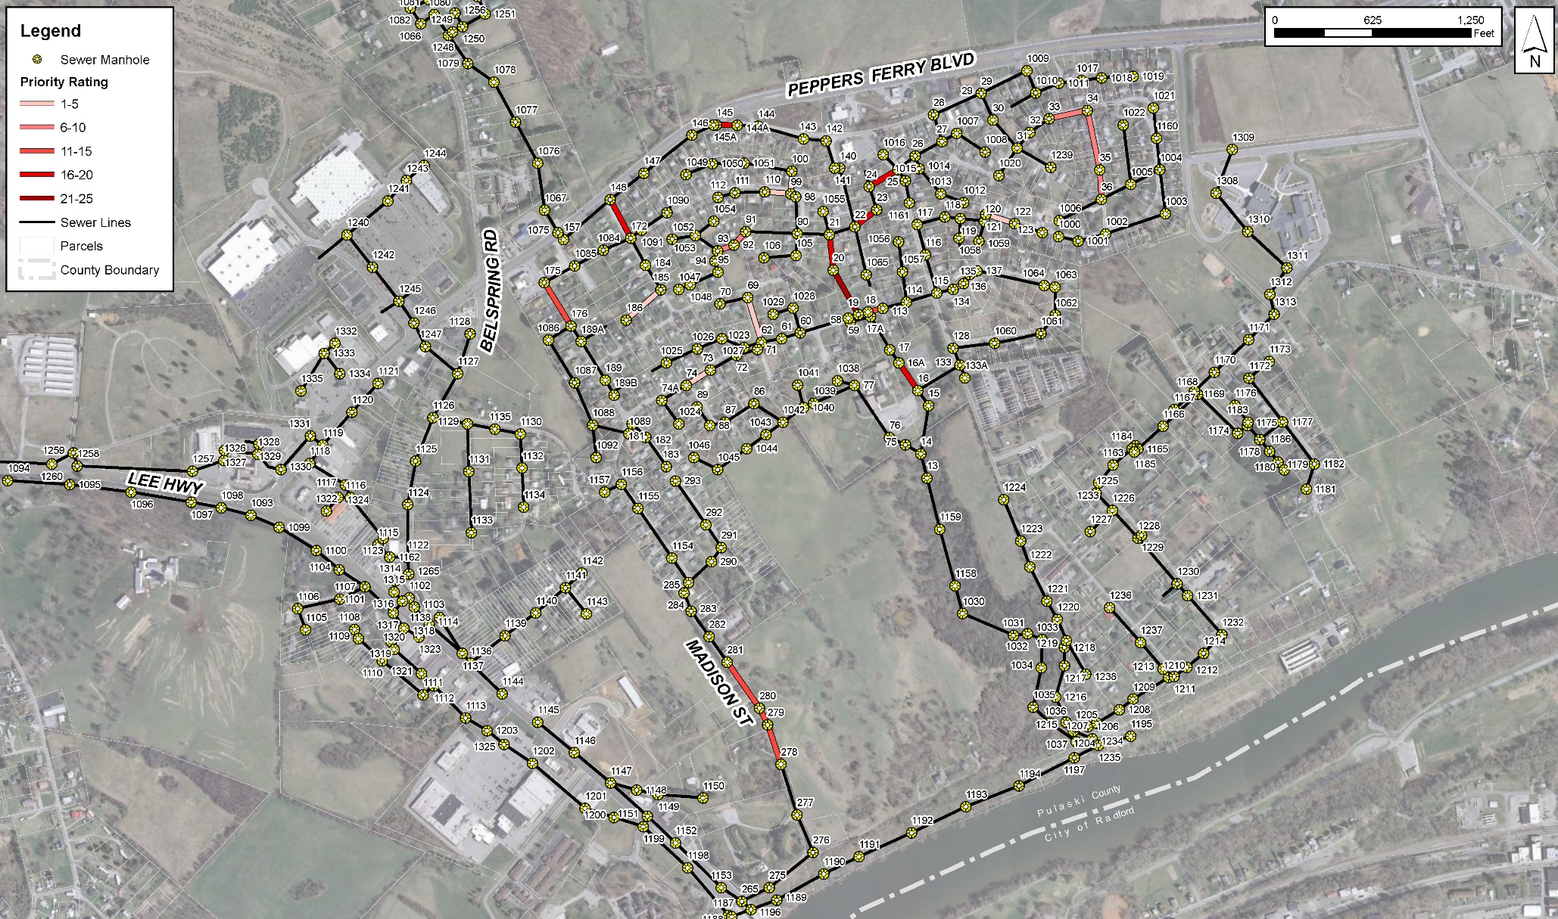
CCTV Inspections
Priority Ranking

Slide 8
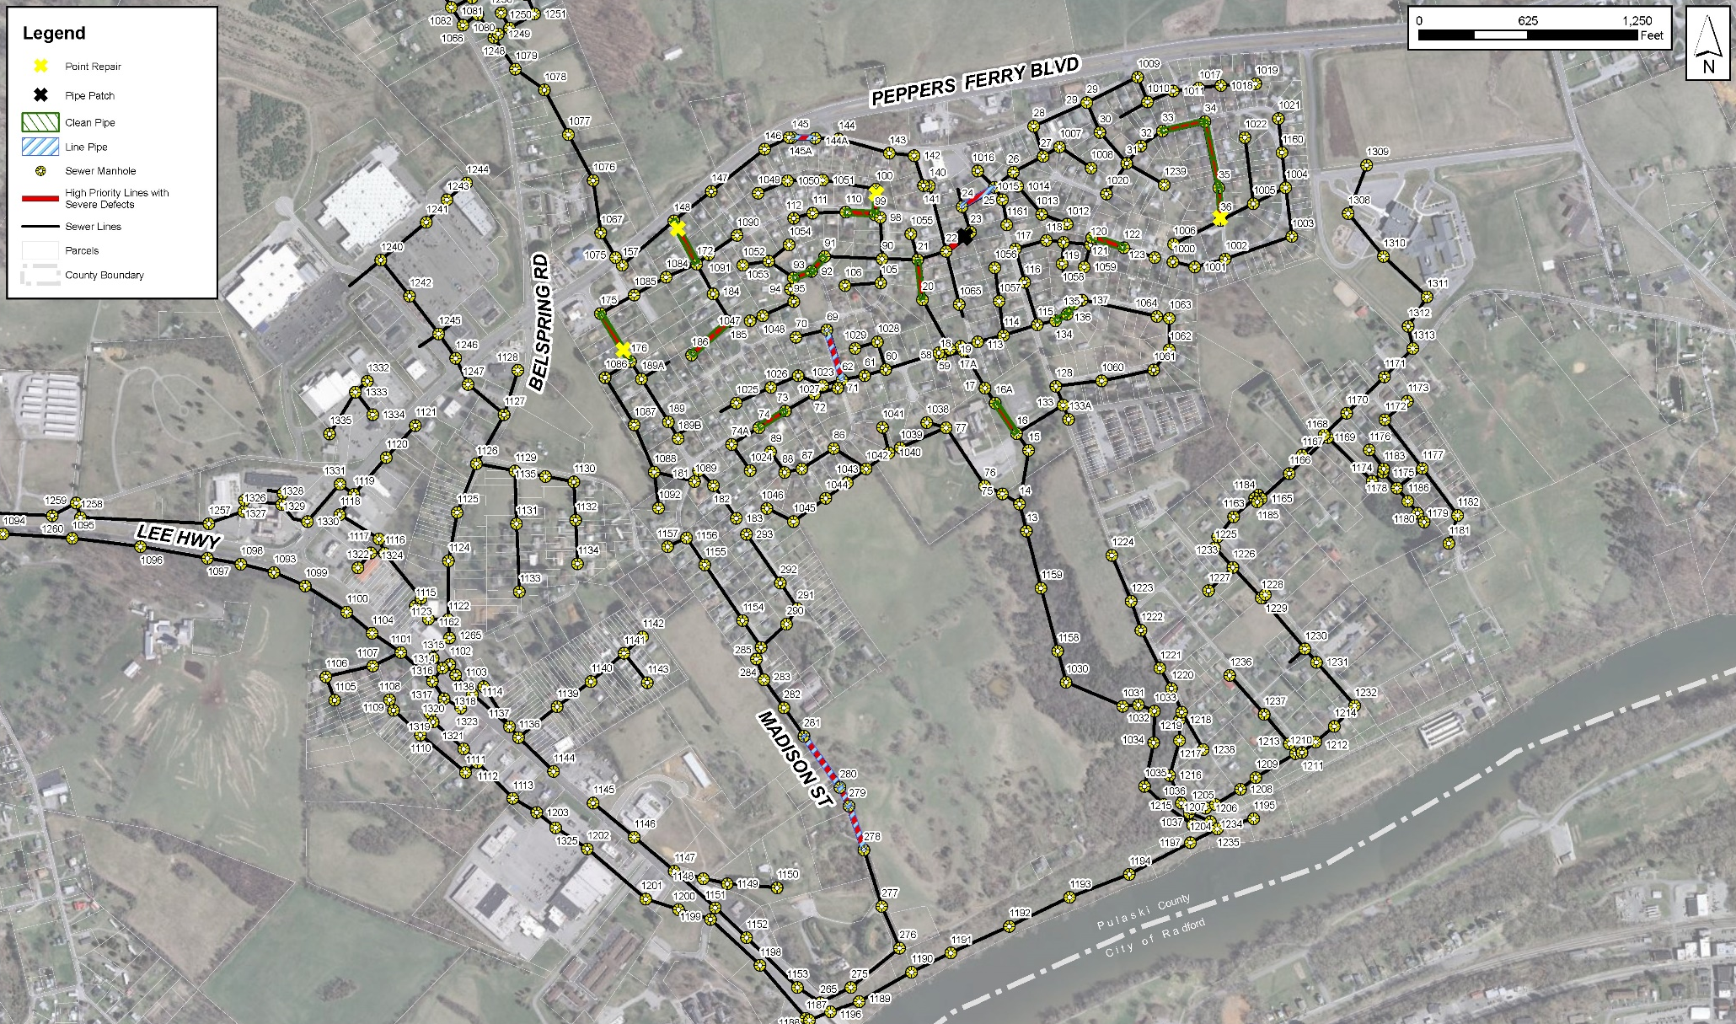
CCTV Inspections
Recommendations

Slide 9
CCTV Inspections
Recommendations (Continued)
Identified High Priority Rehabilitation Costs for Inspected Pipe: $124,500
  Cleaning: 3,520 LF
  Root Cutting: 1,665 LF
  CIPP (Lining): 1,680 LF
  Point Repairs / Pipe Patch: 7 count
Recommended CCTV Inspection per year (15,000 LF Phases): $30,000
Project | Year
 | Phase 1 |  | Phase 2 |  | Phase 3
 | 2018 | 2019 | 2020 | 2021 | 2022 | 2023
CCTV Inspection (15,000 LF) | $30,000 | - | $30,000 | - | $30,000 | -
Maintenance and Repairs | - | $124,500 | - | $90,000 | - | $90,000
Project | Year
 | Phase 4 |  | Phase 5 |  | Phase 6
 | 2024 | 2025 | 2026 | 2027 | 2028 | 2029
CCTV Inspection (15,000 LF) | $30,000 | - | $30,000 | - | $30,000 | -
Maintenance and Repairs | - | $90,000 | - | $90,000 | - | $90,000

Slide 10
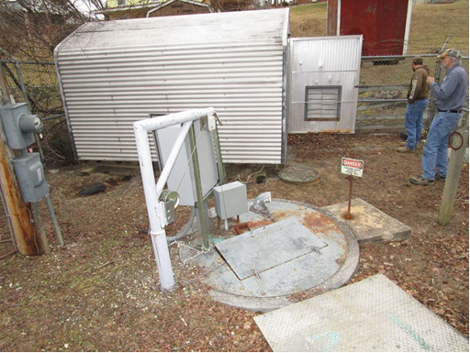
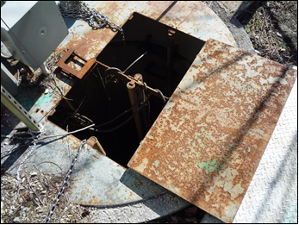
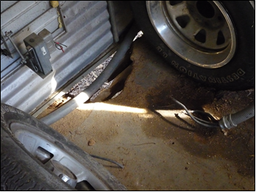
Lift Station Inspections
Brooklyn Lift Station
Priority | Deficiency | Recommended Action | Cost Estimate ($)
High | No Audible or Visual Alarm – In the case of an autodialer failure or power outage to the autodialer, local audible and visual alarms are recommended | Install alarm light and speaker | $1,500
Moderate | Heavy Corrosion on Wet Well Access Hatch – This could be a safety and security issue. As the top continues to degrade, metal could fall and damage the pumps and could lead to a catastrophic safety concern. | Replace wet well access hatch | $2,500
Low | Valve Vault Access Hatch Missing Hinges and Latch – This could be a safety and security issue, but is not likely to fail or cause operational issues. | Replace valve vault access hatch | $2,500
Low | Control Building Flooring – Hole in floor could be a safety and security concern issue, but is not likely to cause operational issues. | Patch/replace flooring | $2,000
Low | Wet Well Infiltration – Evidence of infiltration/seepage through wet well walls | Install wet well liner or coat with epoxy coating | $10,000
Total: |  |  | $18,500

Slide 11
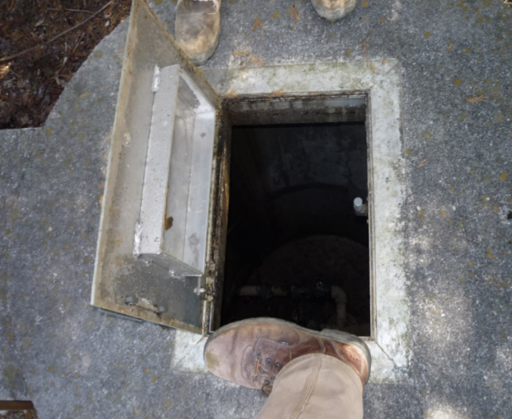
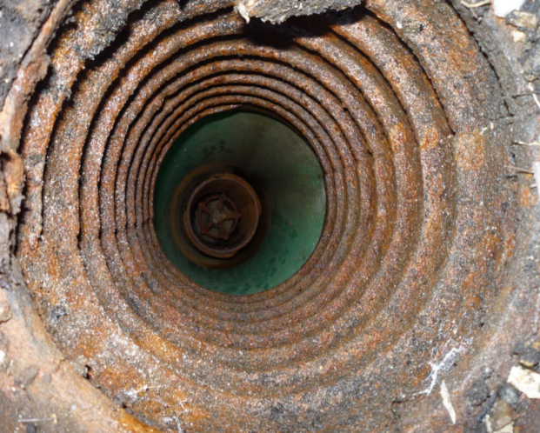
Lift Station Inspections
Bellspring Lift Station
Priority | Deficiency | Recommended Action | Cost Estimate ($)
High | No Emergency Generator Connection – In the case of a power failure, a generator connection is recommended to maintain service and decrease the potential for overflows. | Install emergency generator connection | $4,500
Moderate | Wet Well Access Hatch Does Not Close - This could be a safety and security issue | Modify or replace wet well access hatch | $1,500
Moderate | Submersible Pumps - One of the pumps did not appear to pump as well as the other. The operator stated that one of the pumps was recently replaced. Typically, the pumps operate in an alternating sequence to distribute the wear and tear equally. Often, if a pump meets its usable life without a catastrophic failure, the corresponding pump is likely to need replacement in the near future. | Prepare for replacement of older pump in the near future | $2,000
Moderate | Valve Vault Hatch is Undersized - This could be a safety and operational/maintenance issue as access is very limited. | Replace with an appropriately sized valve vault hatch | $3,500
Low | Deep Installation Hand Valve - This valve will require a special extension operator and will be more likely to break than a traditional square nut operator. | Replace valve | $2,000
Low | Missing Post Caps and Falling Barbed Wire in Fence - Fence posts without caps can collect rainwater and cause rust and degradation to the fence shortening its usable life. | Install fence post caps and reattach falling barbed wire | $500
Low | Concrete Section Between Lift Station and Valve Vault is being Undermined - The soil is eroding away beneath the concrete in this section, which may lead to a failure in the concrete section. | Repair/replace concrete section | $2,000
Total: |  |  | $16,000

Slide 12
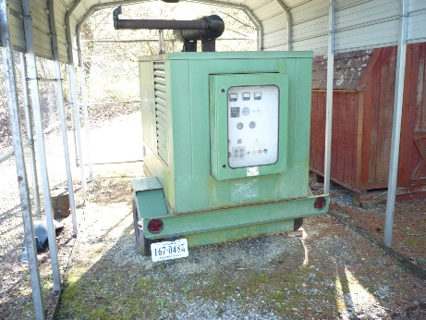
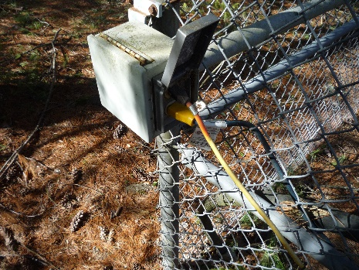
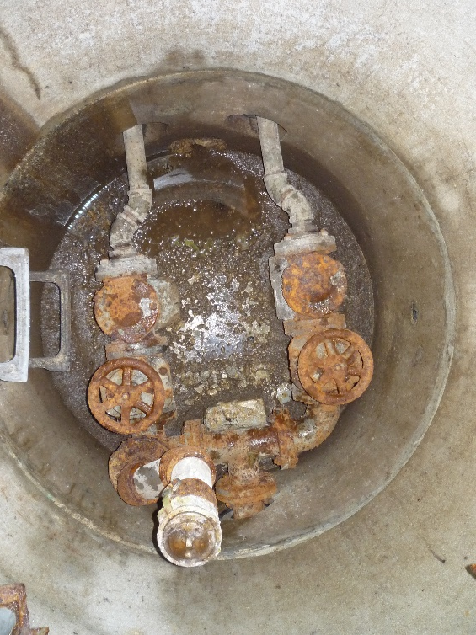
Lift Station Inspections
Timberlane Lift Station
Priority | Deficiency | Recommended Action | Cost Estimate ($)
High | Flat or Low Tire Pressure on Emergency Generator – If this is the only generator for multiple pump stations, the tires need to be operable in case of an emergency | Replace/repair tire | -
High | Heavy Corrosion on Force Main Discharge Valves - If these valves are corroded to the point that they are inoperable, the check valves will not be able to be replaced without emptying the force main. | Replace corroded valves | $2,500
High | Heavy Corrosion on Valves and Piping in Valve Vault - As these check valves, gate valves, and air release valve corrode, they become inoperable and can lead to other potential failures. | Replace valves and piping within the valve vault; Replace the penetration seals between the valve vault and wet well to keep hydrogen sulfide from entering the valve vault | $12,000
Moderate | Exposed Power Cords - Power cords are permanently plugged into an outdoor receptacle. This could be a safety and security issue, as outdoor receptacles are not meant to be used as a permanent power source. | Install conduit to end point | $1,000
Low | Tree Debris in Wet Well and Valve Vault - While surrounding trees make for a good buffer they are causing increased debris to enter the wet well / treatment process. | Remove tree debris and conduct tree pruning / maintenance | -
Total: |  |  | $15,500

Slide 13
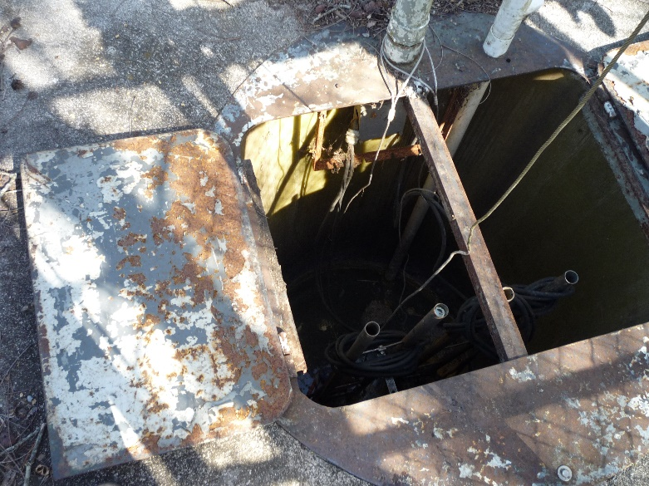
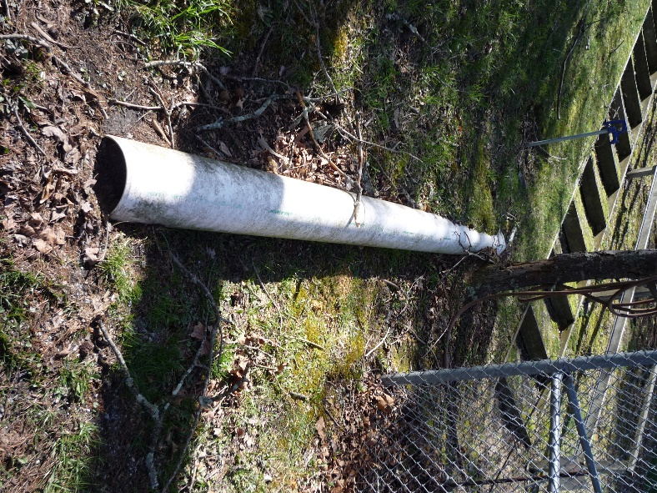
Lift Station Inspections
White Birch Lift Station
Priority | Deficiency | Recommended Action | Cost Estimate ($)
High | No Audible or Visual Alarm – In the case of an autodialer failure or power outage to the autodialer, local audible and visual alarms are recommended. | Install alarm light and speaker | $1,500
High | Power Disconnect Switch is not Secured – This could be a safety and security issue. Anyone would be able to turn off the pump station without the PCSA knowing. | Secure the disconnect switch with a lock | -
Moderate | Submersible Pumps - One of the pumps did not appear to pump as well as the other. | Prepare for replacement pump in the near future | $2,000
Moderate | Moderate Corrosion on Wet Well Access Hatch - This could be a safety and security issue. As the top continues to degrade, metal could fall and damage the pumps and could lead to a catastrophic safety concern. | Replace wet well access hatch | $2,500
Low | Falling Barbed Wire on Fence – Falling barbed wire could be a safety and security concern. | Repare falling barbed wire | $500
Low | Drainage Pipe is Full of Debris and Joint is Separating - This drainage pipe collects the majority of the surface flow coming off White Birch Lane and is intended to direct the flow past the pump station. It appears that the pipe is nearly full of sediment and one of the joints is separating. As the flow continues to collect in this pipe and discharge through the joint, surface water from this area will flow towards the pump station becoming a possible source of inflow. | Replace or clean drainage pipe | $1,000
Total: |  |  | $7,500

Slide 14
Lift Station Inspections
Summary
Summary of Findings:
Heavy corrosion of valves, rails, wet well/vault covers, etc.
Heavy grease deposits
Signs of potential areas of infiltration
Aging submersible pumps
Cost Estimates:
Priority | Cost Estimate ($)
High | $22,000
Moderate | $15,000
Low | $20,500
Total | $57,500

Slide 15
Rate Analysis
  Approach:
    Reviewed current water usage
    Reviewed existing expenses
    Developed estimated expenses – including pump station improvements, additional condition assessment, sewer line rehabilitation

Slide 16
Rate Analysis
  Goals:
    Generate adequate revenue to pay treatment costs and other operating expenses
    Generate adequate revenue to address additional condition assessment activities on an ongoing basis
    Fund sewer line rehabilitation on an ongoing basis
    Bill customers based on water usage
    Develop rates that are fair and equitable

Slide 17
Current Revenues / Projected Expenses
(assumes NO rate increases)
 | 2018 (Budget) | 2019 (Budget) | 2020 | 2021 | 2022 | 2023 | 2024
Revenues:
Sewer Fees | $ 395,280 | $ 395,280 | $ 395,280 | $ 395,280 | $ 395,280 | $ 395,280 | $ 395,280
Interest Income | $ - | $ 4,200 | $ - | $ - | $ - | $ - | $ -
Connection Fees | $ - | $ 5,100 | $ 5,100 | $ 5,100 | $ 5,100 | $ 5,100 | $ 5,100
Miscellaneous | $ - | $ 2,300 | $ 2,300 | $ 2,300 | $ 2,300 | $ 2,300 | $ 2,300
Total Operating Revenues | $ 395,280 | $ 406,880 | $ 402,680 | $ 402,680 | $ 402,680 | $ 402,680 | $ 402,680
Operating Expenses:
Operating Expenses | $ 188,600 | $ 170,236 | $ 168,706 | $ 165,231 | $ 173,301 | $ 182,038 | $ 191,504
Peppers Ferry Regional WWTP | $ 206,580 | $ 220,000 | $ 233,200 | $ 247,192 | $ 262,024 | $ 277,745 | $ 294,410
Capital Projects:
Pump Station Improvements | $ - | $ 18,667 | $ 18,667 | $ 18,667 | $ - | $ - | $ -
CCTV Inspection (5 phases) | $ - | $ - | $ 30,000 | $ - | $ 30,000 | $ - | $ 30,000
Sewer Line Rehab (Phase 1) | $ - | $ 45,833 | $ 45,833 | $ 45,833 | $ - | $ - | $ -
Sewer Line Rehab (Phase 2) | $ - | $ - | $ - | $ 45,000 | $ 45,000 | $ - | $ -
Sewer Line Rehab (Phase 3) | $ - | $ - | $ - | $ - | $ - | $ 45,000 | $ 45,000
Sewer Line Rehab (Phases 4&5) | $ - | $ - | $ - | $ - | $ - | $ - | $ -
Total Operating Expenses | $ 395,180 | $ 454,736 | $ 496,406 | $ 521,923 | $ 510,325 | $ 504,783 | $ 560,914
Net / Revenue Available | $ 100 | $ (47,856) | $ (93,726) | $ (119,243) | $ (107,645) | $ (102,103) | $ (158,234)
% Increase Needed in Revenue |  | 12.1% | 23.7% | 30.2% | 27.2% | 25.8% | 40.0%

Slide 18
Options Considered
  PCSA Board Considered Five (5) Options for Setting Rates:
    Considered various base charges
    Evaluated 0 gallons – 3,000 gallons in the base charge
    Evaluated various rates for usage in excess of the minimum

Slide 19
Recommended Residential Rates
 | Current Rates | Recommended Rate
Non-User Charge (per month) | $ 10.00 | $ 13.00
 | Current Rates | Recommended Rate
Base Rate (per month) | $ 23.00 | $ 24.00
Consumption Charge ($ per 1,000 gallons) | N/A | $ 1.25
Gallons in Minimum | N/A | 1,000
Water Usage | Current Charge | Recommended Rate | Increase
up to 1,000 gallons | $ 23.00 | $ 24.00 | $ 1.00
2,000 | $ 23.00 | $ 25.25 | $ 2.25
3,000 | $ 23.00 | $ 26.50 | $ 3.50
4,000 | $ 23.00 | $ 27.75 | $ 4.75
5,000 | $ 23.00 | $ 29.00 | $ 6.00
6,000 | $ 23.00 | $ 30.25 | $ 7.25
7,000 | $ 23.00 | $ 31.50 | $ 8.50
8,000 | $ 23.00 | $ 32.75 | $ 9.75
9,000 | $ 23.00 | $ 34.00 | $ 11.00
10,000 | $ 23.00 | $ 35.25 | $ 12.25
15,000 | $ 23.00 | $ 41.50 | $ 18.50
Note: Approximately 60% of the residential customers use 3,000 gallons of water, or less, per month.

Slide 20
Recommended Non-Residential Rates
 | Current Rates | Recommended Rate
Base Rate (per month) | $ 23.00 | $ 25.30
Consumption Charge | $ 4.00 | $ 4.40
Gallons in Minimum | N/A | N/A
Water Usage | Current Charge | Recommended Charge | Increase
<1,000 Gallons | $ 23.00 | $ 25.30 | $ 2.30
1,000 | $ 27.00 | 29.70 | $ 2.70
2,000 | $ 31.00 | 34.10 | $ 3.10
3,000 | $ 35.00 | 38.50 | $ 3.50
4,000 | $ 39.00 | 42.90 | $ 3.90
5,000 | $ 43.00 | 47.30 | $ 4.30
6,000 | $ 47.00 | 51.70 | $ 4.70
7,000 | $ 51.00 | 56.10 | $ 5.10
8,000 | $ 55.00 | 60.50 | $ 5.50
9,000 | $ 59.00 | 64.90 | $ 5.90
10,000 | $ 63.00 | 69.30 | $ 6.30
20,000 | $ 103.00 | 113.30 | $ 10.30
30,000 | $ 143.00 | 157.30 | $ 14.30
40,000 | $ 183.00 | 201.30 | $ 18.30
50,000 | $ 223.00 | 245.30 | $ 22.30
100,000 | $ 423.00 | 465.30 | $ 42.30
150,000 | $ 623.00 | 685.30 | $ 62.30
Note: Approximately 40% of the non-residential customers use 1,000 gallons of water, or less, per month; approximately 30% use 2,000 – 10,000 gallons per month and 30% use in excess of 10,000 gallons per month.

Slide 21
Summary – Recommended Rates
Recommended rates meet the projected expenses for FY2019
Most residential customers will see a monthly increase of $1.00 - $3.50
Non-residential customers will see an increase of 10%
Additional rate increases may be needed in the future
PCSA Board will need to evaluate each year

Slide 22
Questions & Open Discussion

